Slide 1
MIAMI UNIVERSITY
CAMPUS SALES
Ling Xiang, Liangdong Jia, Weiqi Hu, Quanda Yang

Slide 2
Client and Mentor
Michael Stahr

Slide 3
PROJECT - CAMPUS SALES
The Campus Sales is a campus-based website that students can trade their items to others on campus.
Benefits:
Don’t need to wait for shipment
Trade quick
Safer (@miamioh.edu)

Slide 4
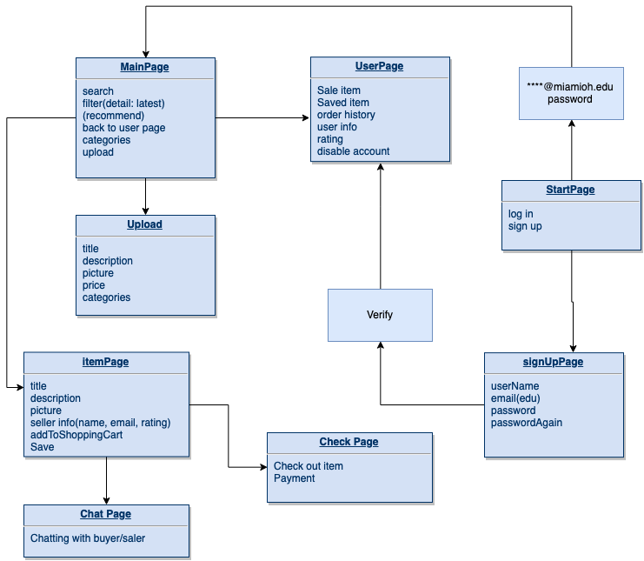
FEATURES

Slide 5
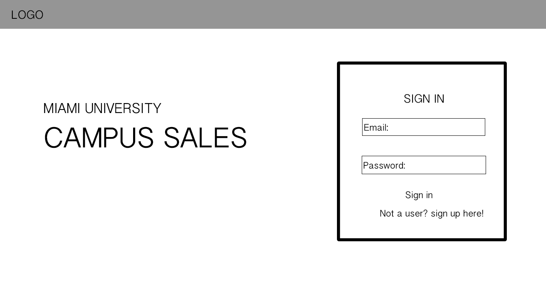
START UP PAGE

Slide 6
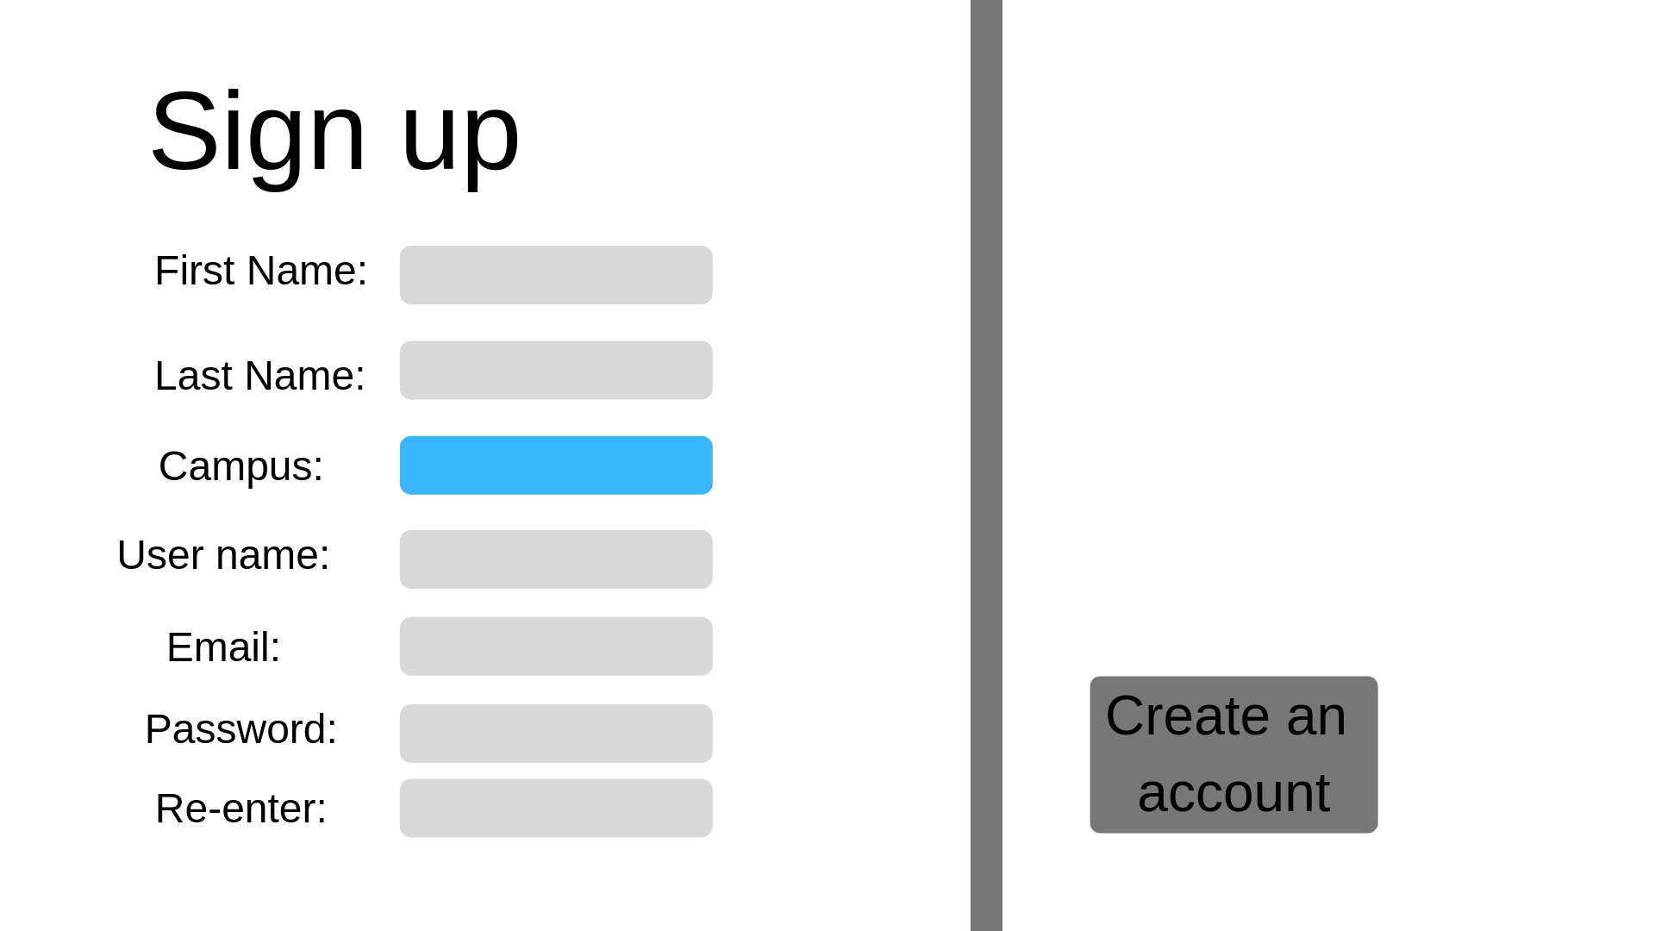
SIGN UP PAGE

Slide 7
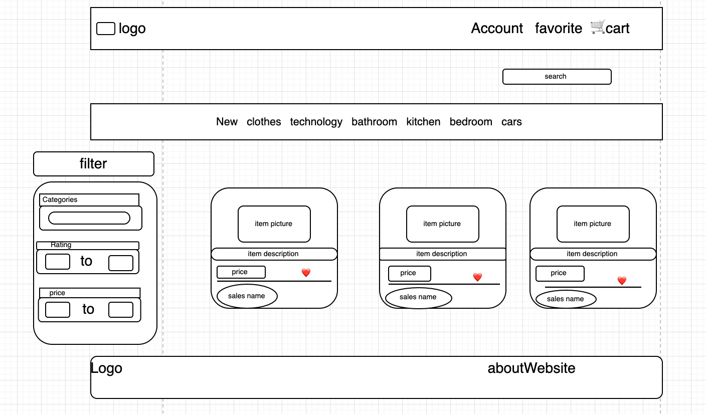
MAIN PAGE

Slide 8
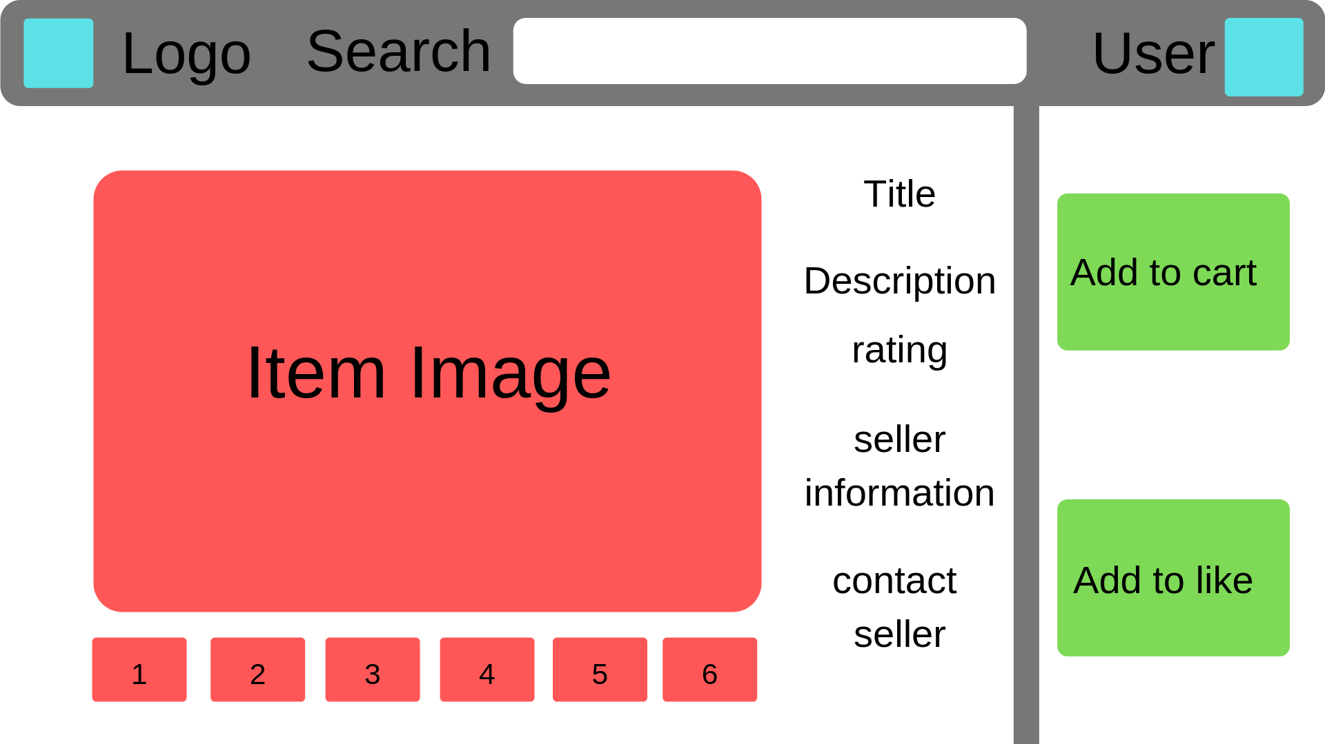
ITEM PAGE

Slide 9
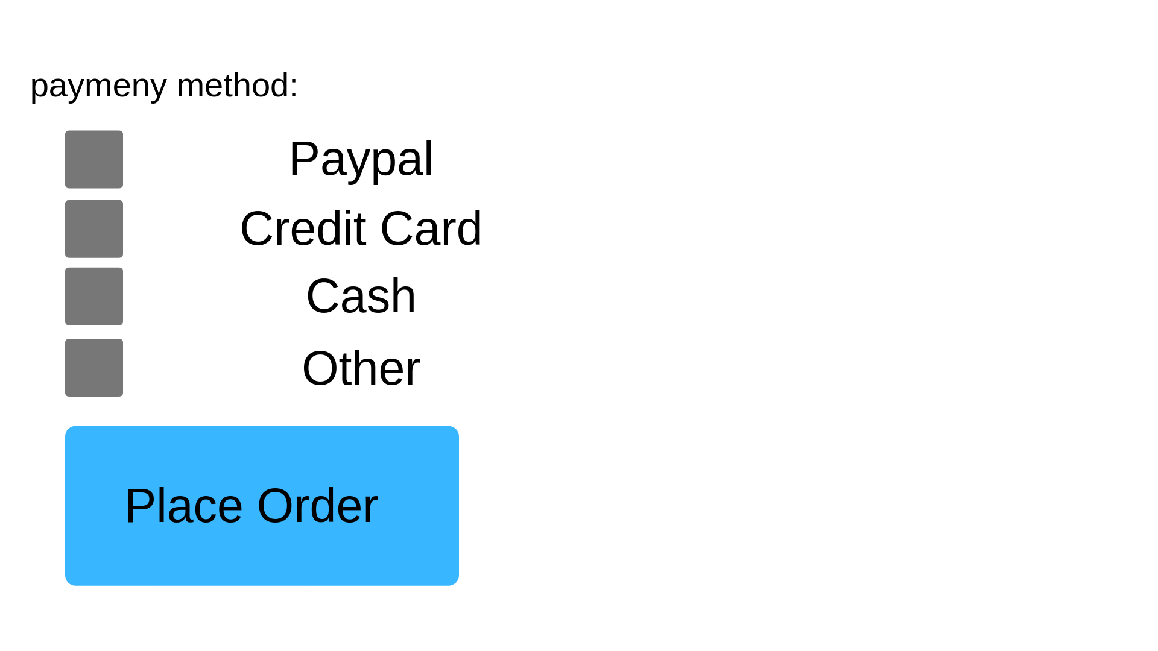
Checkout page

Slide 10
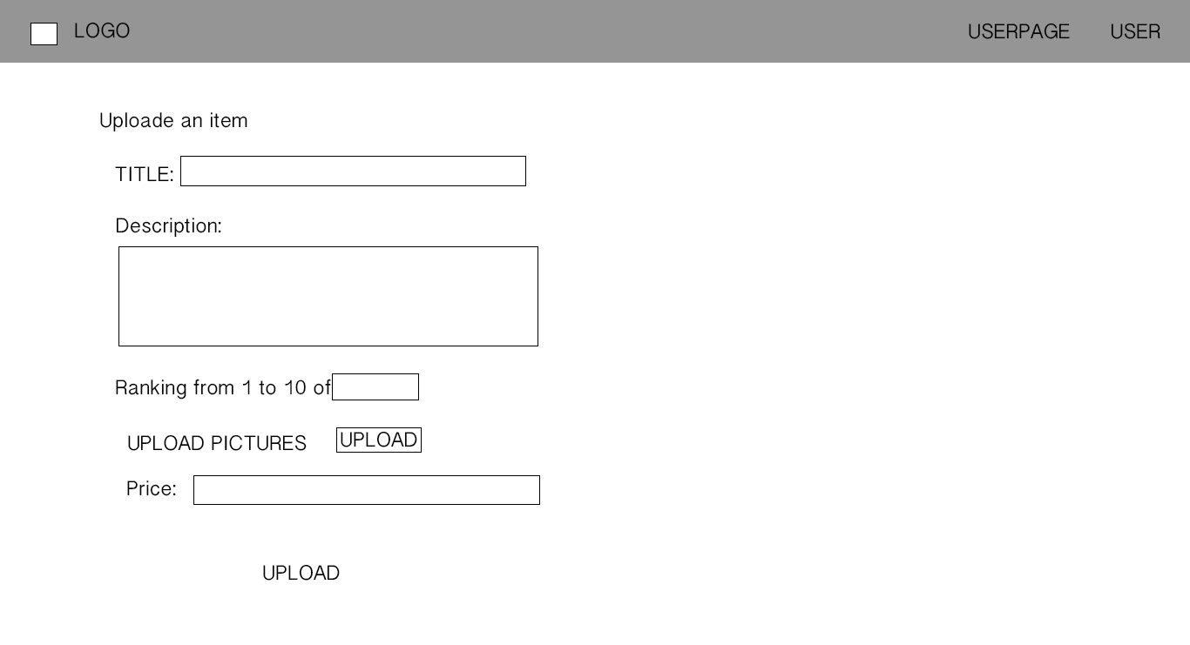
UPLOAD ITEM PAGE

Slide 11
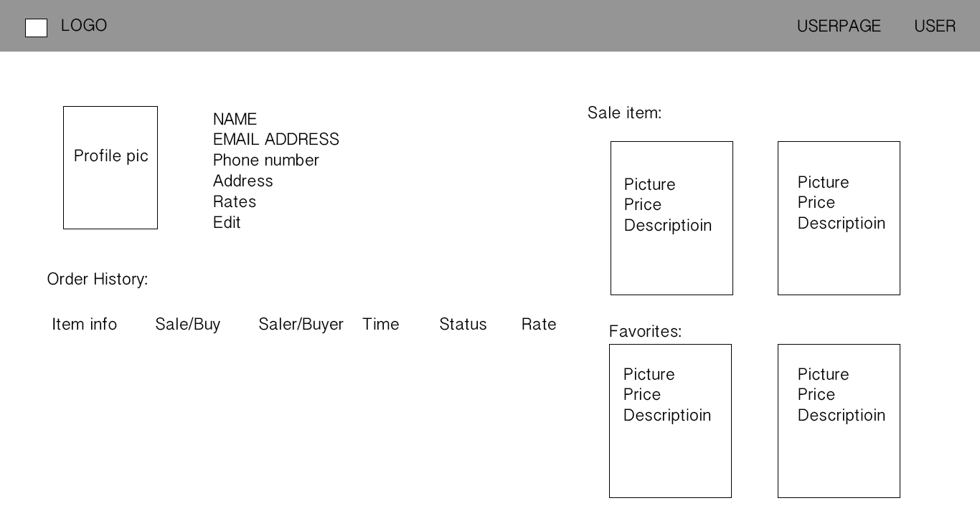
USER PAGE

Slide 12
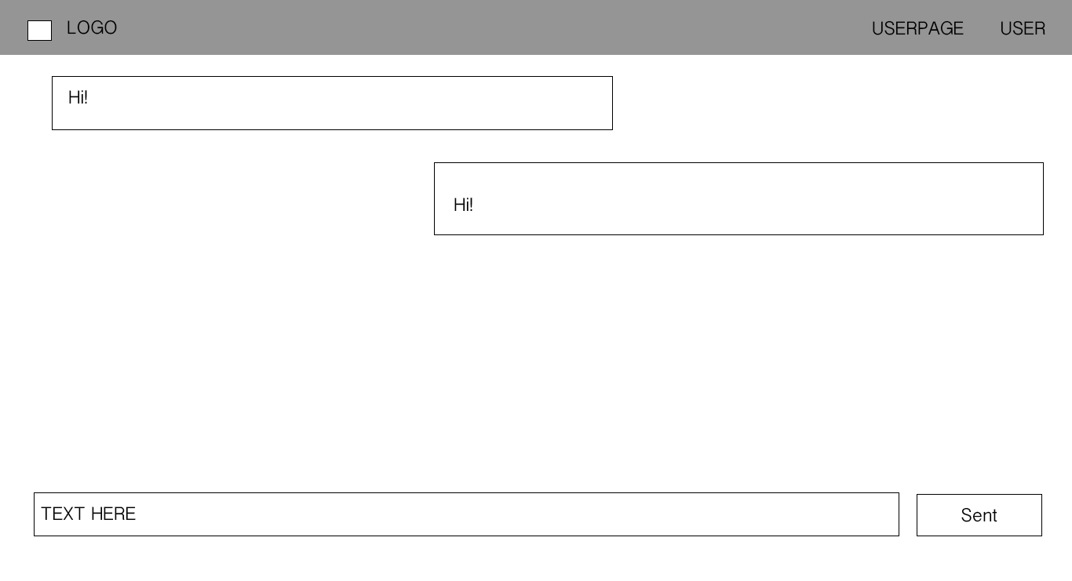
CHAT PAGE

Slide 13
Technologies
Database
.Net
Html
Others

Slide 14
GOAL
Finish Designing
Create web frames
Starting up with database
Having some small features down

Slide 15
Questions?

Slide 16
THANK YOU!

